Slide 1

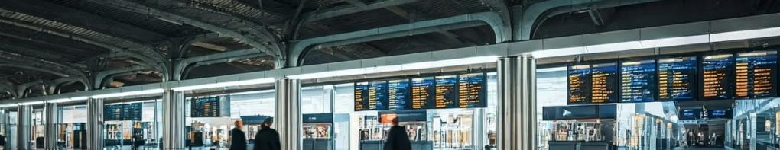
Multi-threaded Railway Reservation System
Core Functionality
Key Features
Selecting Seats, Canceling, and Payment Checks
Prevents overbooking by managing multiple threads safely. Built using Java with proper concurrency control.
Presented by: Om, Aditya, Ayushi, Khushboo

Slide 2




Project Overview
Java-based system
Core functionalities
Multi-user safe
Simulates real-world railway ticket booking
Seat selection, ticket cancellation, payment validation
Designed with threads and synchronization

Slide 3


Problem Statement
Simultaneous access
Overbooking risk
Multiple users booking the same seat
Without synchronization, seats are duplicated
Data inconsistency
Payment and booking records diverge

Slide 4

Objectives
✔
Real-time booking
Enable instant seat selection
✔
Flexible cancellations
Allow refunds for tickets
✔
Payment validation
Confirm status before booking
✔
Multi-user support
Handle concurrent requests with Java synchronization

Slide 5





Technologies Used
Java
JDBC & MySQL
Swing (Optional)
GitHub
Core logic and threading
Database connectivity and storage
Version control and collaboration
User interface (frontend)

Slide 6





System Workflow
User interaction
Opens interface, selects train/seat
Seat locking
System secures selected seat
Payment validation
Ensures payment is successful
Booking confirmation
Updates database, offers cancellation
Thread management
All steps handled concurrently

Slide 7
Thread Handling
Shared data, like seat lists, protected by synchronized blocks.
Prevents:
Overbooking
Multiple users simulated using distinct threads.
Payment race conditions
Critical sections are atomic, preventing interruptions.
Inconsistent booking records

Slide 8
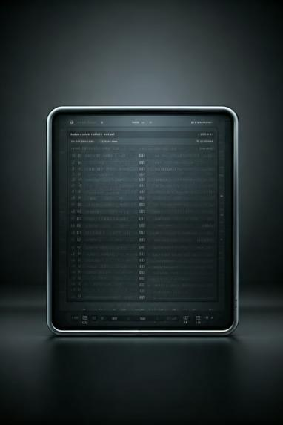
Database Schema
Field
Type
Description
booking_id
INT (PK)
Auto-generated unique ID
passenger_name
VARCHAR
User's full name
seat_number
INT
Selected seat number
status
VARCHAR
Booked / Cancelled
payment_status
VARCHAR
Paid / Failed / Refunded

Slide 9

Challenges & Solutions
1
Overbooking
Synchronized methods
2
Simultaneous access
Java threads with locking
3
Payment issues
Validated before booking
4
Data inconsistency
DAO pattern + transaction control

Slide 10

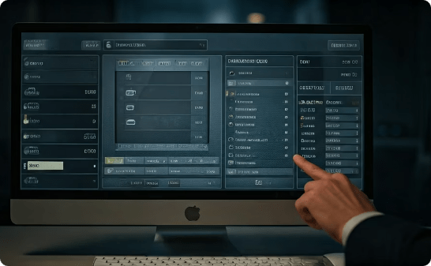
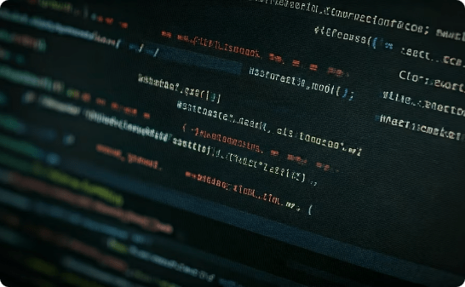
Conclusion & Thank You
Thread-safe Ticket Booking
Seat Selection & Cancellation
Java Concurrency & Database Design
Reliable and concurrent system handling multiple users
Interactive booking with flexible ticket management
Demonstrates practical use of Java threads and data storage
GitHub: https://github.com/4ditxya/concurrent-railway-booking

